Slide 1
Exercise Break App
Group 29 - Ash Kandari, Ben Deschand, Nilesh Jain, Soham Pradhan

Slide 2
Project Description
The project is designed to help make running and jogging less strenuous of an exercise by letting users know to take appropriate breaks.
The domain of the project does not necessarily belongs to any specific business as it targets any person who wants to have a better time exercising.
The goal of the application would be helping endurance trainers or those who just want to go on jog to have a better exercise experience. The hope is by making endurance exercise more fun and less strenuous, they will feel more inclined to do these types of exercises and foster healthier habits.

Slide 3
How does it work?
The application relies on a heart beat sensor that is a feature in most of the smartwatches present today.
The heartbeat sensor keeps track of the heartbeat and sends that data to the application (real time data).
The application uses that data while the user is on the run and calculates what their optimal heartbeat should be during the run, factoring in the kind of exercise they are doing.
If the application sees that the heartbeat has passed the threshold it notifies the user to take a break, during this break they are also reminded to rehydrate.
If the user either ran out or forgot their drink, the application can
also help them navigate to a closest store.

Slide 4
Functional Requirements
Starting a break: When the application sees that the heartbeat has crossed the threshold it should notify the user to take a break, if agreed by the user it keeps monitoring the heartbeat and lets them know when it reaches an appropriate level.
Ending a break: During the whole break, the sensor will be analyzing the heartbeat of the user. Once the user’s heartbeat stabilizes, the app will let the user know that they can continue with the exercise.
Locating a Store and Finding route: The program should be able to work with google maps and find the location of nearby stores and eventually find a way to that store.

Slide 5
Data Requirements
User Information: It is essential for the application to store user data which includes age, height and weight, as the application uses this data to create a threshold that is unique to each user.
Email: The email the User puts in must be properly formatted, with the @ sign and a period found.

Slide 6
Test plans
A: The test checks the accuracy and latency of heart monitor
Adaptability and Scalability Check: The test checks if the application keeps track of multiple users and performs highly in the appropriate environment.
Application Latency Check: The test checks if the time to get the account information is less than three seconds.
User Privacy Check: The test checks if the application protects the privacy of every one involved in the application and is safe against malwares.At
Application Maintenance and Support Check: The test checks if the user data is updated and checked and the user is given technical support whenever needed.

Slide 7
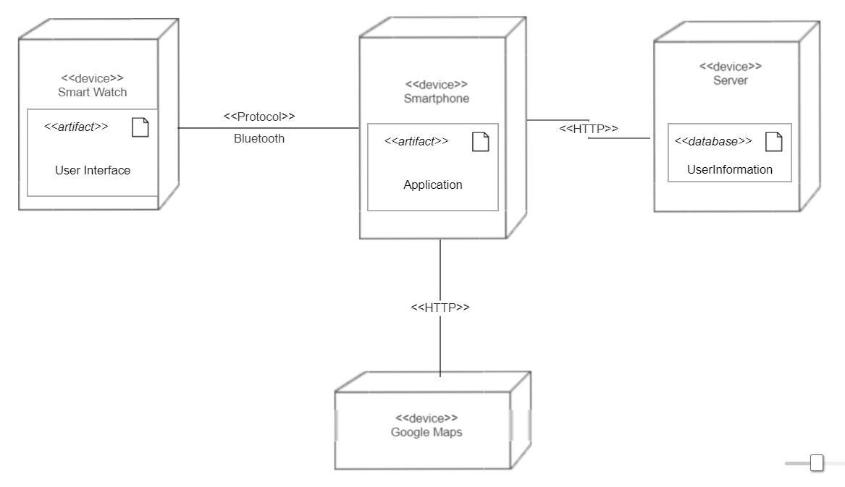
Deployment Diagram

Slide 8
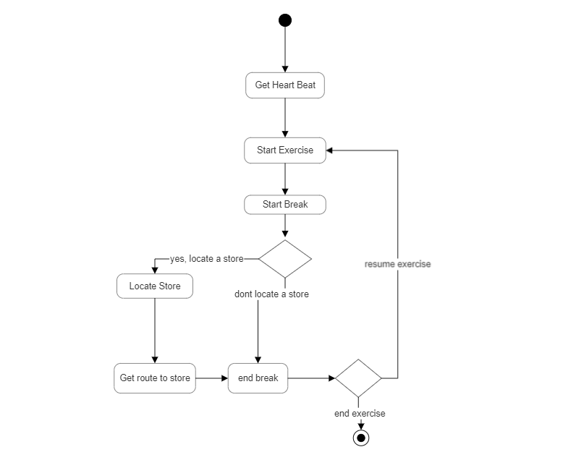
Activity
Diagram

Slide 9
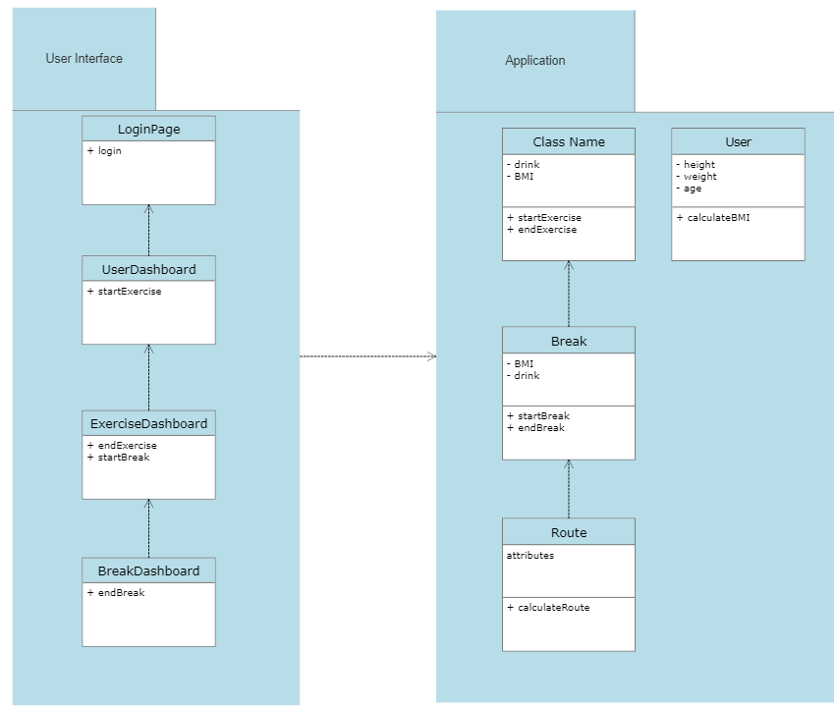
Subsystems

Slide 10
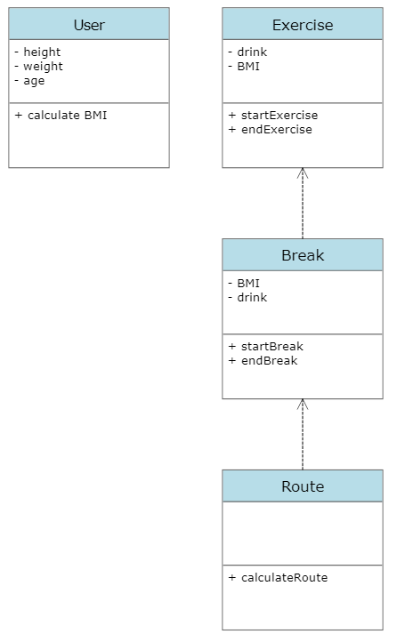
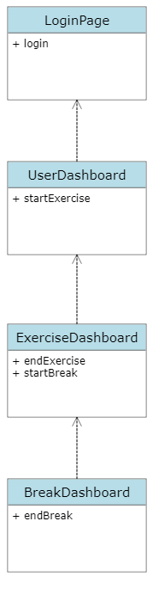
UML (Class) Diagrams

Slide 11
Thank You

